Slide 1
CS6301 Intro to Robot Manipulation and Navigation
Team 13 RL-based Top-Down Grasping with a focus on Selective Shapes
Abhishek Chauhan
Shreeprasad Sonar
Vedang Wartikar

Slide 2
About the Project
Top-Down Grasping: Involves the robot positioning itself above the target object for manipulation where the robot's camera system is oriented downward, allowing it to analyze the scene from an overhead viewpoint
Reinforcement Learning: A type of machine learning concept where an agent (DQN/DDPG) learns by interacting with an environment (robot arm + target object), receiving feedback in the form of rewards or penalties for its actions (grasps)
Selective Shape Manipulation: Extend/Modify the RL-based approach to grasp specific shapes using the Robot’s arm. Tweak the rewards to incentivize the grasp of a specific object that user specifies

Slide 3
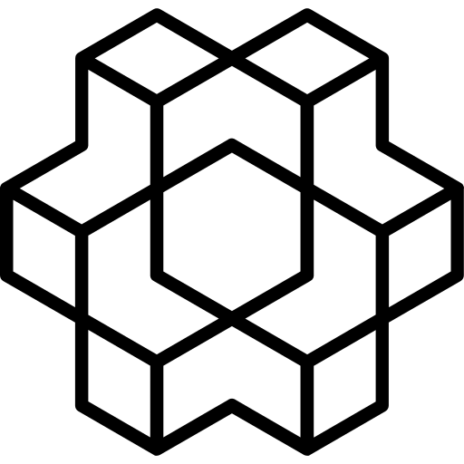

Simulation Environment
+
⇔
stable-baselines
OpenAI Gym
Forked from openai/baselines
PyBullet

Slide 4
Deep Q - Network (DQN)
1. Reinforcement Learning Framework: In reinforcement learning, an agent learns to interact with an environment by taking actions to maximize a cumulative reward.
2. Q-Learning: Q-learning is a classic reinforcement learning technique that aims to learn the quality (Q-value) of taking a specific action in a given state. The Q-value represents the expected cumulative reward the agent will receive by taking that action and following the optimal policy thereafter.
3. Deep Q-Network: DQN uses a neural network to approximate the Q-value function. The neural network takes the environment's state as input and outputs Q-values for each possible action. This allows the agent to estimate the best action to take in a given state.

Slide 5
Deep Deterministic Policy Gradient (DDPG)
1. Continuous Action Spaces: Continuous action spaces (DDPG) are spaces where the action space is a continuous set of values, such as the position of an object. Discrete action spaces (DQN) are spaces where the action space is a set of discrete values, such as the buttons that an agent can press.
2. Actor-Critic Architecture:
Actor Network: The actor is responsible for learning the policy directly, mapping states to specific actions.
Critic Network: The critic evaluates the actions chosen by the actor by estimating the Q-value function.
3. Deterministic Policy Gradient: Allows the actor network to directly learn the optimal policy in continuous action spaces without the complexities involved in learning a stochastic policy.

Slide 6
Reward Function
The reward function in reinforcement learning serves as a crucial guiding principle.
If it successfully picks up the correct object, then reward given is 1, otherwise if it grabs the incorrect object, then -1 reward is given.

Slide 7
Training
For the environment, we added 2 shapes to the environment , a cuboid and a cube . The intended behaviour is to pick up the cube as specified by the user.
Then, we've trained our reinforcement learning (RL) model using two algorithms, DQN and DDPG. Our model employs RGB as the perception layer, the custom reward function and learns for a minimum of 10000 timesteps.
Successfully picking up the cube among different objects
Failed to pick up the cube among different objects

Slide 8
Demo Video
The demo video for the project is listed here : https://youtu.be/KAYMQ7sokI4

Slide 9
Current Status of our Work
Completed:
Create a simulation environment
Train DQN and DDPG algorithms for grasping using RGB sensor system
Test the model on different target objects (cube, cuboid, sphere)
In Progress:
Modify the reward function to incentivize grasping of select shapes
Fine-tune parameters of the RL algorithms to optimize the model

Slide 10
– End of presentation –

